Slide 1
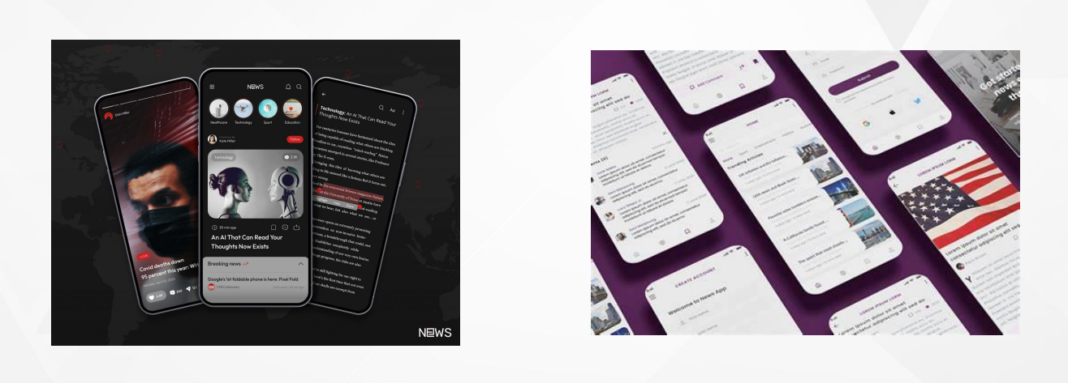
NEWS FEED APP

Slide 2
MY TEAM MEMBERS : A.GAYATHRI A.SWEATHA M.SRI LEKHA S.VETHAABINAYA

Slide 3
OBJECTIVE
The objective of the news feed app is to provide users with timely, relevant, and personalized news content from diverse and credible sources. It aims to enhance user engagement through interactive features such as comments, shares, and reactions, while maintaining a clean, intuitive interface for seamless navigation. The app will deliver real-time notifications for breaking news and critical updates, and offer the ability to save articles for offline reading. Ensuring trustworthiness and accuracy, the app will prioritize news from reliable, verified sources, fostering a sense of credibility and user confidence.

Slide 4
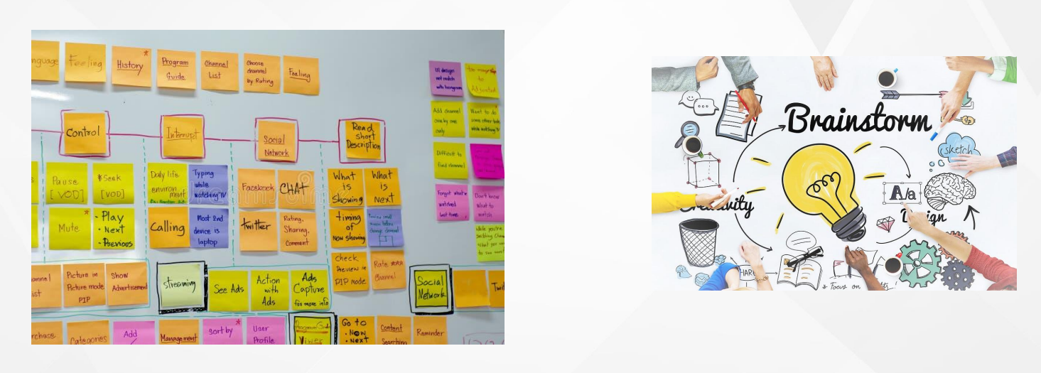
BRAINSTORMING

Slide 5
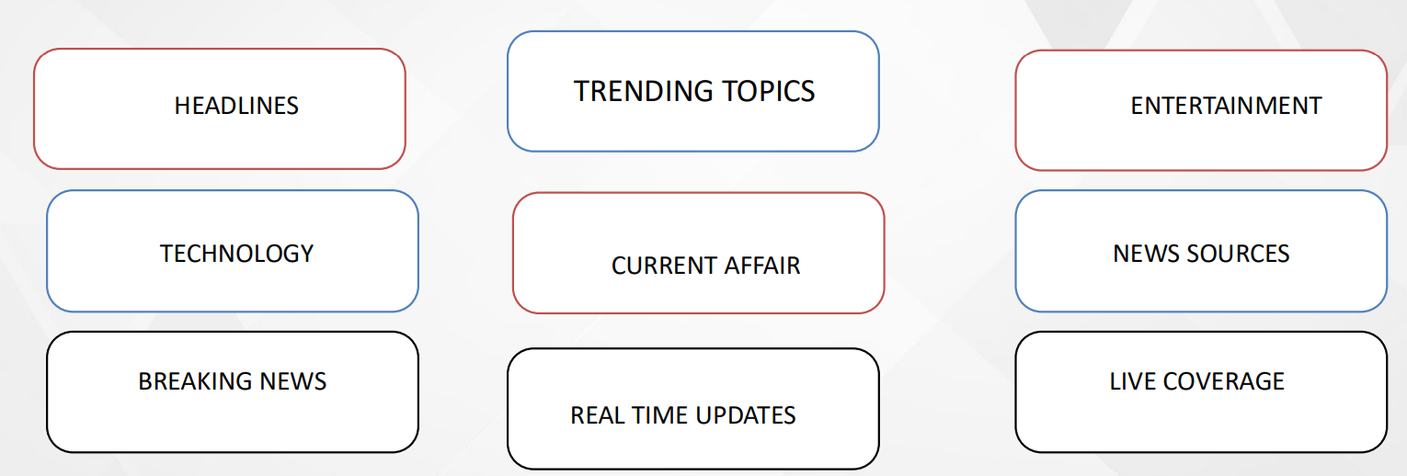
KEYWORDS

Slide 6
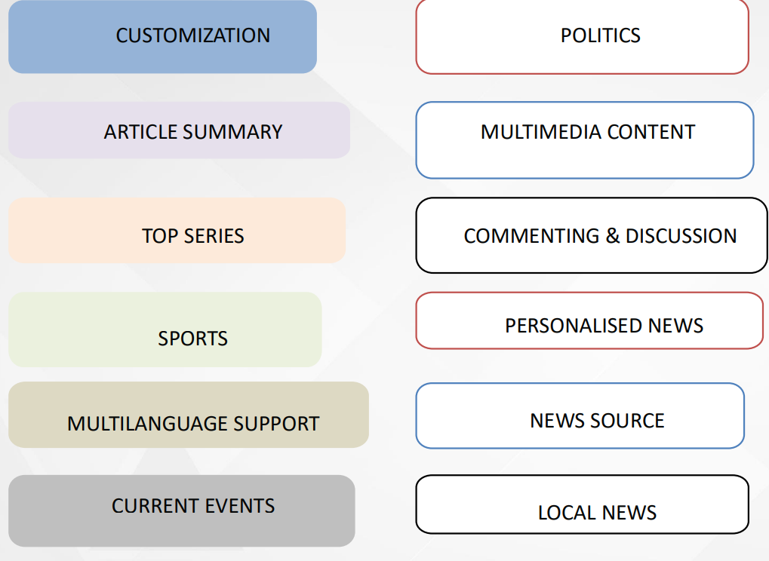
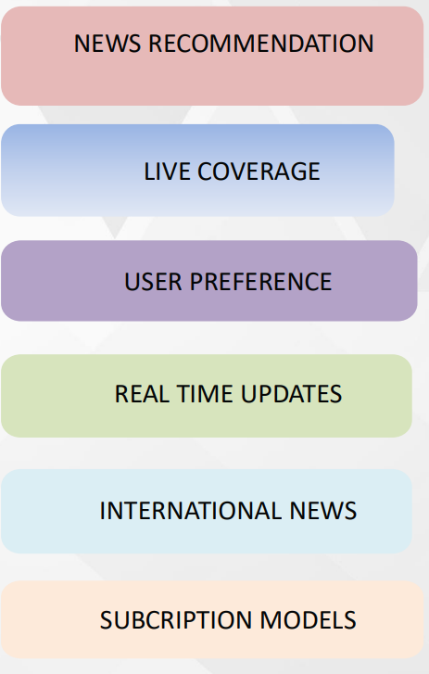


Slide 7
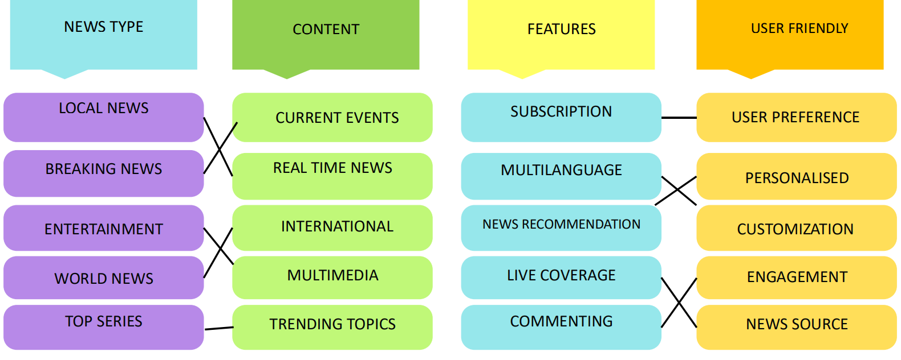
SORTING AND AFFINITY LINK

Slide 8

MIND MAPPING

Slide 9
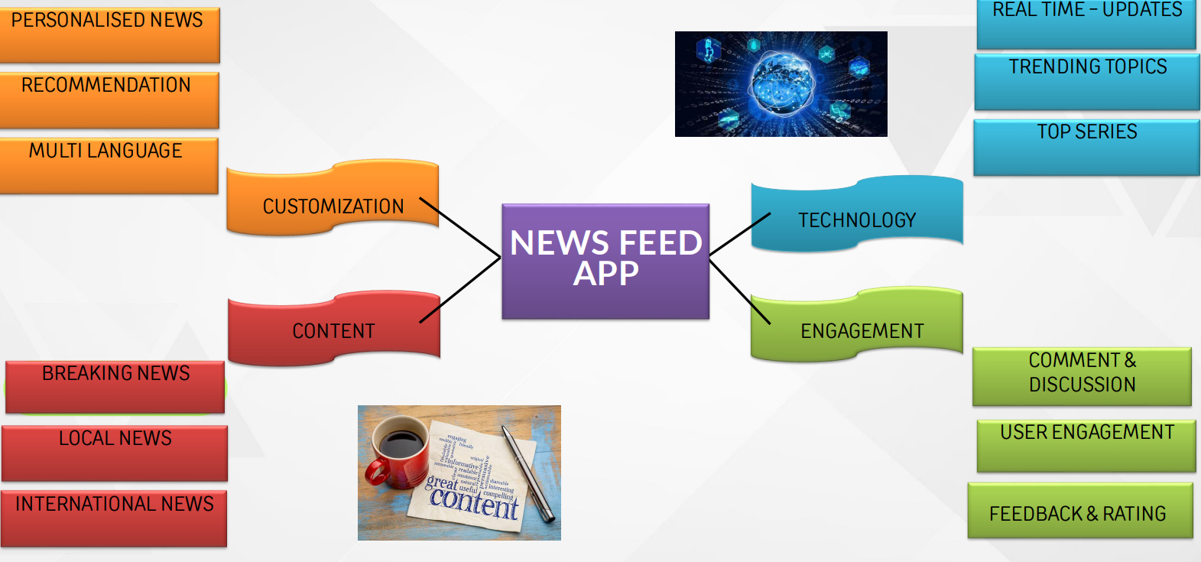

Slide 10
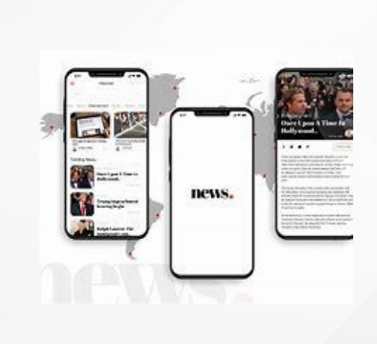
MATRIX TABLE

Slide 11
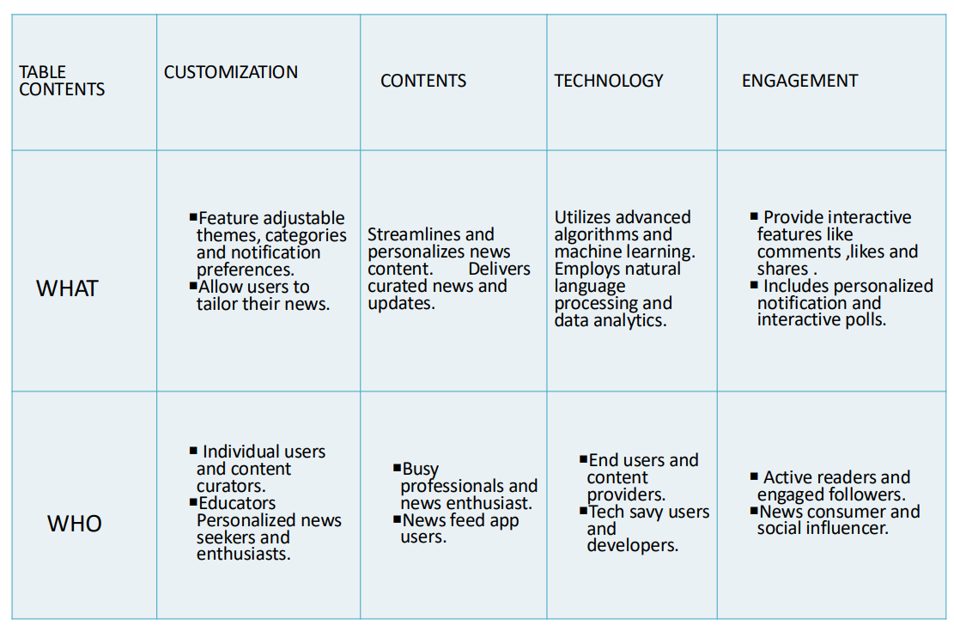
MATRIX TABLE FOR NEWS FEED APP

Slide 12
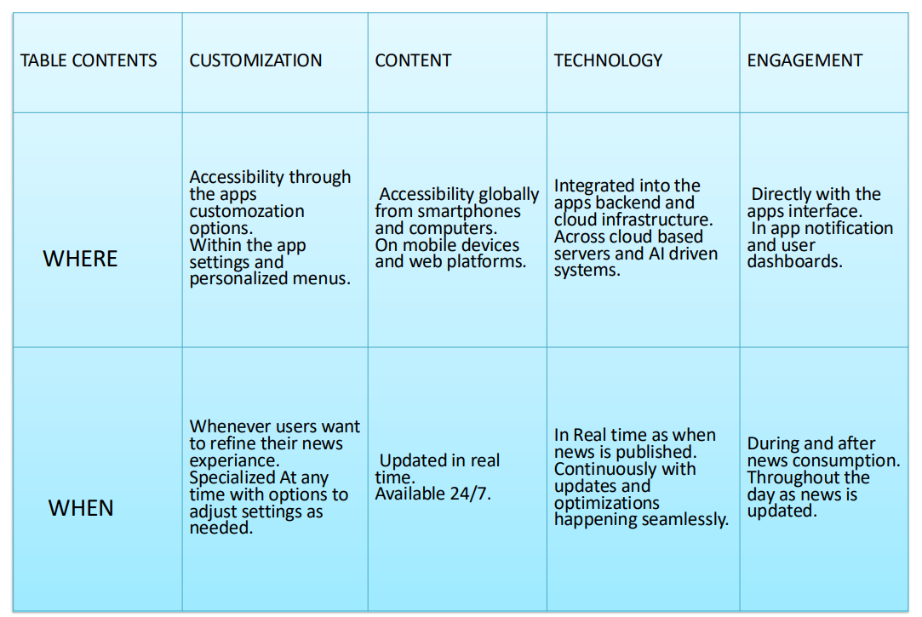

Slide 13
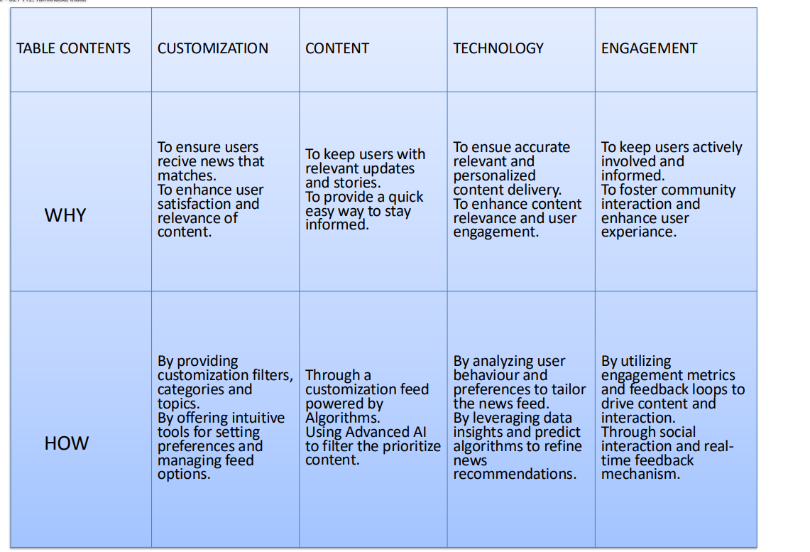

Slide 14
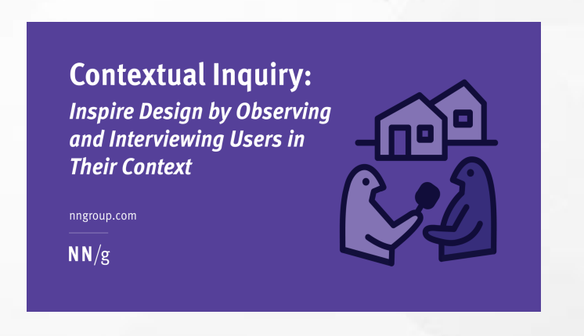
CONTEXTUAL INQUIRY

Slide 15
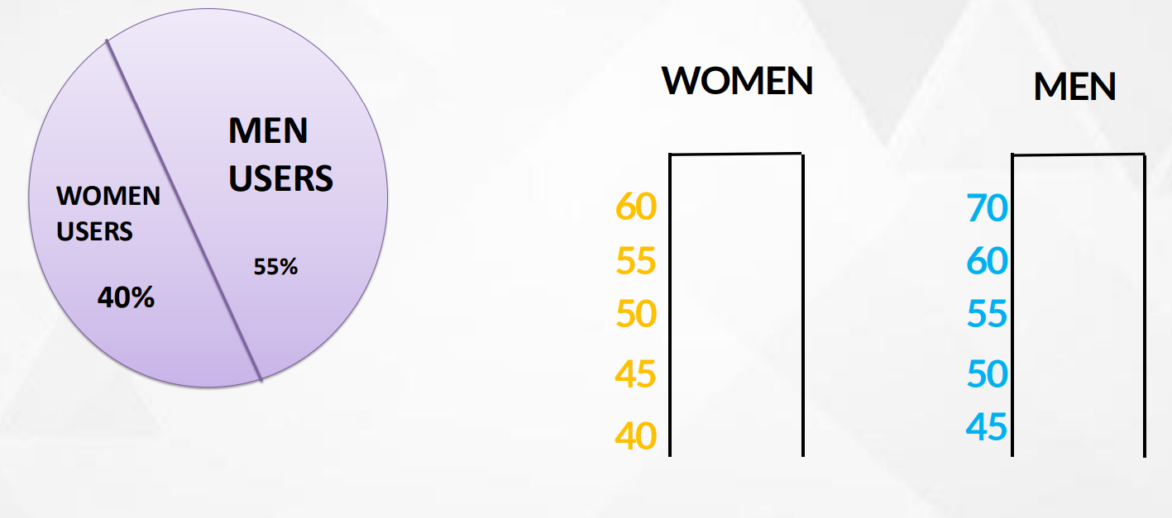
DEMOGRAPHICS

Slide 16
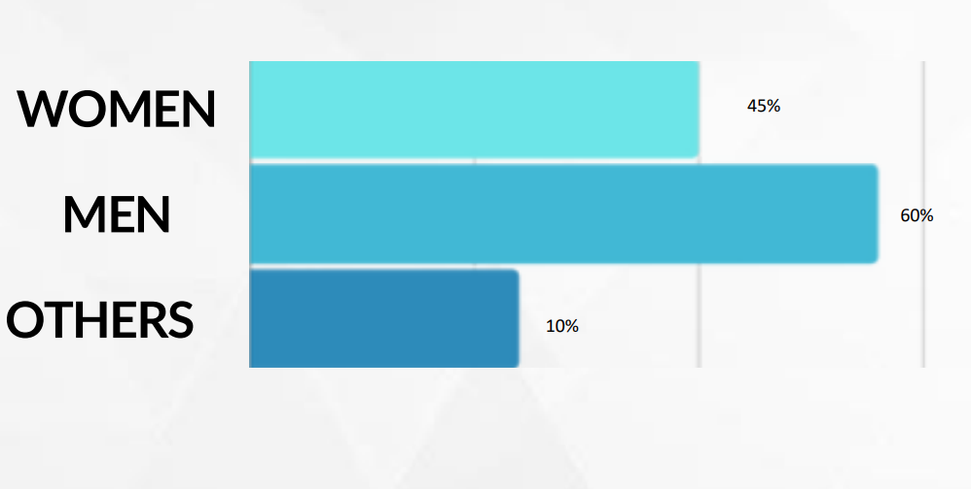
APP USAGE

Slide 17
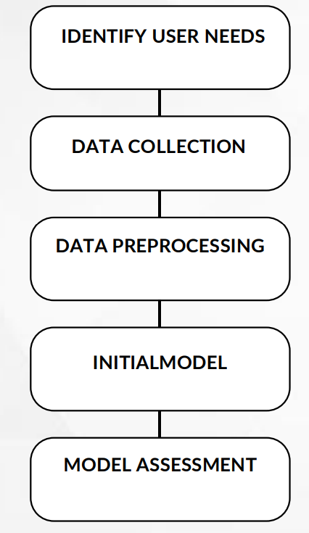
CONCEPTUAL MODEL

Slide 18
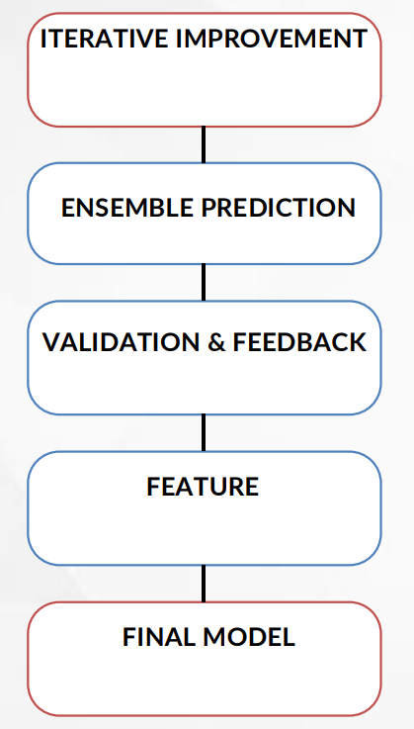
CONCEPTUAL MODEL

Slide 19

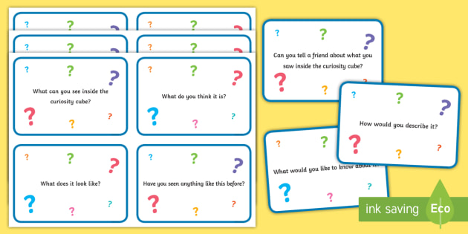
QUESTIONARIES & CUE CARDS

Slide 20
OPEN ENDED QUESTION
1. WHAT ASPECTS OF THE APP MAKE IT EASY OR CHALLENGING TO NEVIGATE ?
2.HOW TO YOU FEEL ABOUT THE FREQUENCY AND TIMING OF NOTIFICATIONS ?

Slide 21
CLOSE ENDED QUESTIONS
User Experience & Interface
Do you find the app's interface easy to navigate?
Yes
No Example answer: Yes
Is the app's loading speed satisfactory?
Yes
No Example answer: No

Slide 22
Cue Card
Title: Welcome!
Message:
Get Started By Exploring The Latest Headlines And Trending Stories.
Customize Your News Feed To Match Your Interests.
Stay Updated With Real-time Notifications.
Action:
Tap Here To Customize Your Preferences.

Slide 23
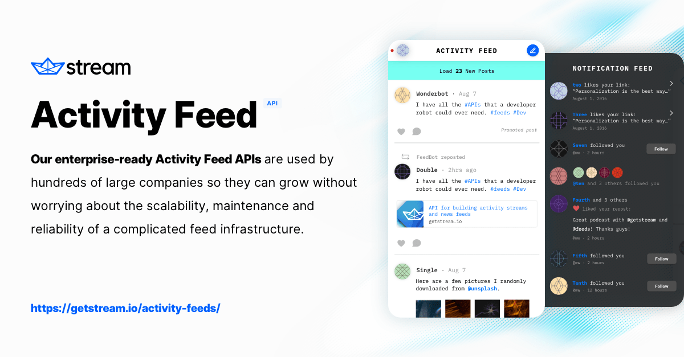
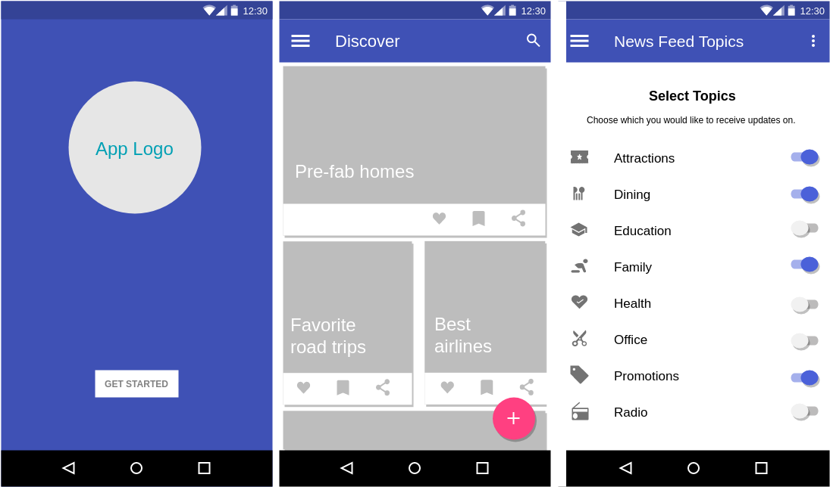
Activity Mapping

Slide 24
Content Intraction
Post Creation
User on
bonding
Search Discovery
Profile Management
Notification
Settting & personalization
Analytics
Logout/Exit

Slide 25


Persona & Make Oior Table

Slide 26
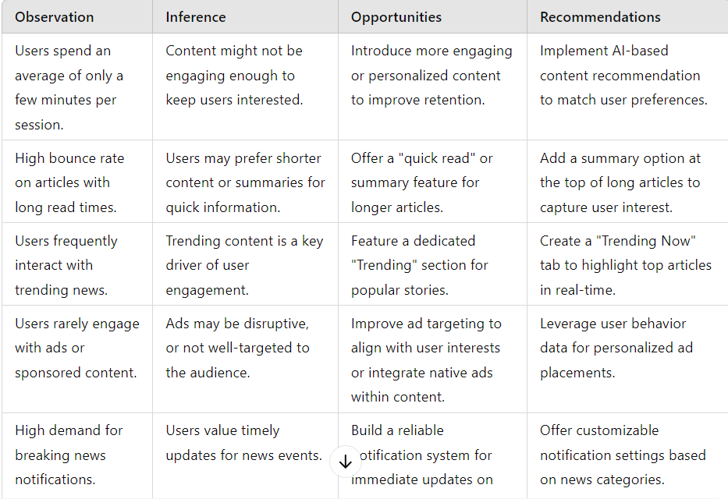
Make Oior Table

Slide 27
Persona
Name: Emily Turner Age: 28 Occupation: Marketing Manager Location: Seattle, Washington
Characteristics:
Tech-Savvy: Frequently uses apps for news, productivity, and social media. Values apps with intuitive interfaces and quick responsiveness.
Time-Conscious: Has a busy schedule and prefers concise news summaries or quick-read articles.

Slide 28
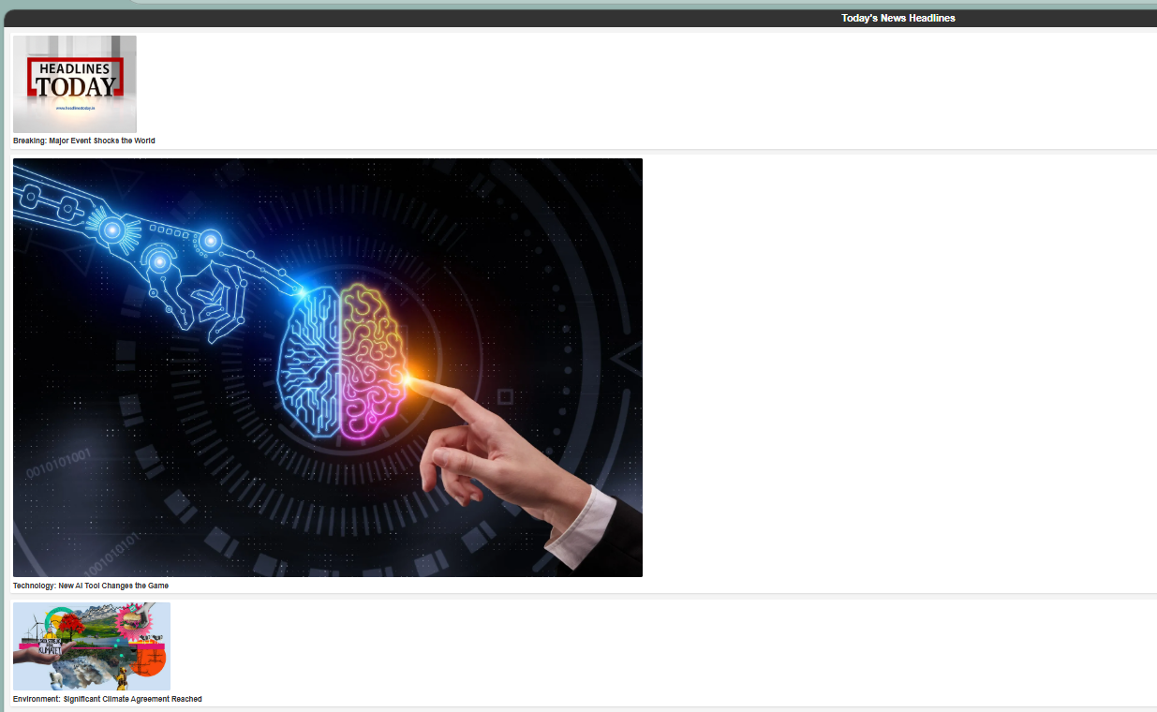
RESULT :

